Slide 1


Identifying a Problem Worth Solving
&
Design Thinking

Slide 2
Contents:
Identifying a Problem Worth Solving:
    Meaning of Problem Worth Solving
    Activity: Find Your Campus Pulse
Design Thinking:
    What is Design Thinking?
    Process of Design Thinking
    Activity: Case Study

Slide 3
Problem Worth Solving
Do you agree that an entrepreneur is always looking for an opportunity - an opportunity which he/she can use to convert into a venture? Often, they identify a problem and use it to create the opportunity. However, identifying a problem is not enough. They need to find out whether the problem is worth solving. Watch Video: Identify a Problem Worth Solving to understand how to do so.

Slide 4
Activity
Team of 6 Members
Identify the list of problems
Find the Solution to solve it
Who is the customers of it?
How much they can pay on it?
What is the size of the customers?
Activism: Check the Campus Pulse

Slide 5
Design Thinking:
Did a mobile phone always look and work the way it does today? Did you even think a “Kindle” was possible? How then did these come into shape – from what? The answer lies in Design Thinking.
There are a bunch of videos on Design Thinking. Watch all of them!
      Video: Say Hello to Design Thinking
      Video: What is Design Thinking?
      Video: Design Thinking Process

Slide 6
What is Design Thinking:
Design Thinking is an iterative process in which we seek to understand the user, challenge assumptions, and redefine problems in an attempt to identify alternative strategies and solutions that might not be instantly apparent with our initial level of understanding. At the same time, Design Thinking provides a solution-based approach to solving problems. It is a way of thinking and working as well as a collection of hands-on methods.

Slide 7
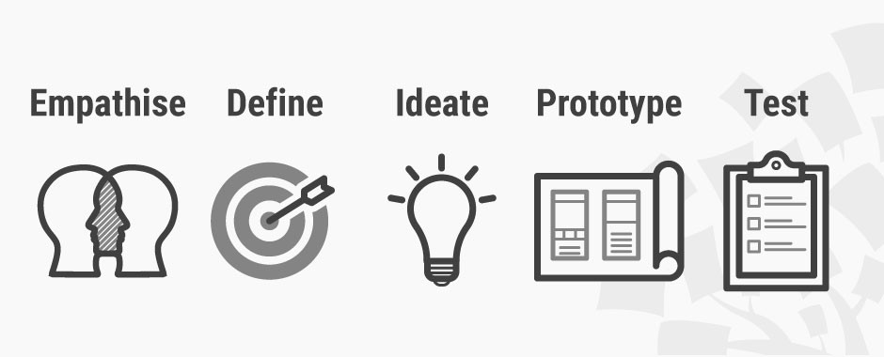
Design Thinking Process:
Empathize – with your users
Define – your users’ needs, their problem, and your insights
Ideate – by challenging assumptions and creating ideas for innovative solutions
Prototype – to start creating solutions
Test – solutions

Slide 8
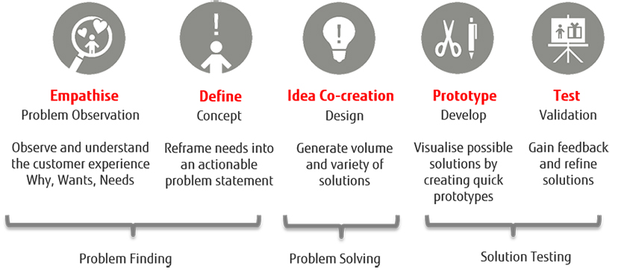

Slide 9
THANK YOU

